Slide 1
Analyzing PM2.5 Concentrations Through Satellite Data in Benin
Benjamin Kramer, Professor Misbath Daouda
Department of Public Health, UC Berkeley
Steer Symposium 2024
Notes:
Title Slide

Slide 2
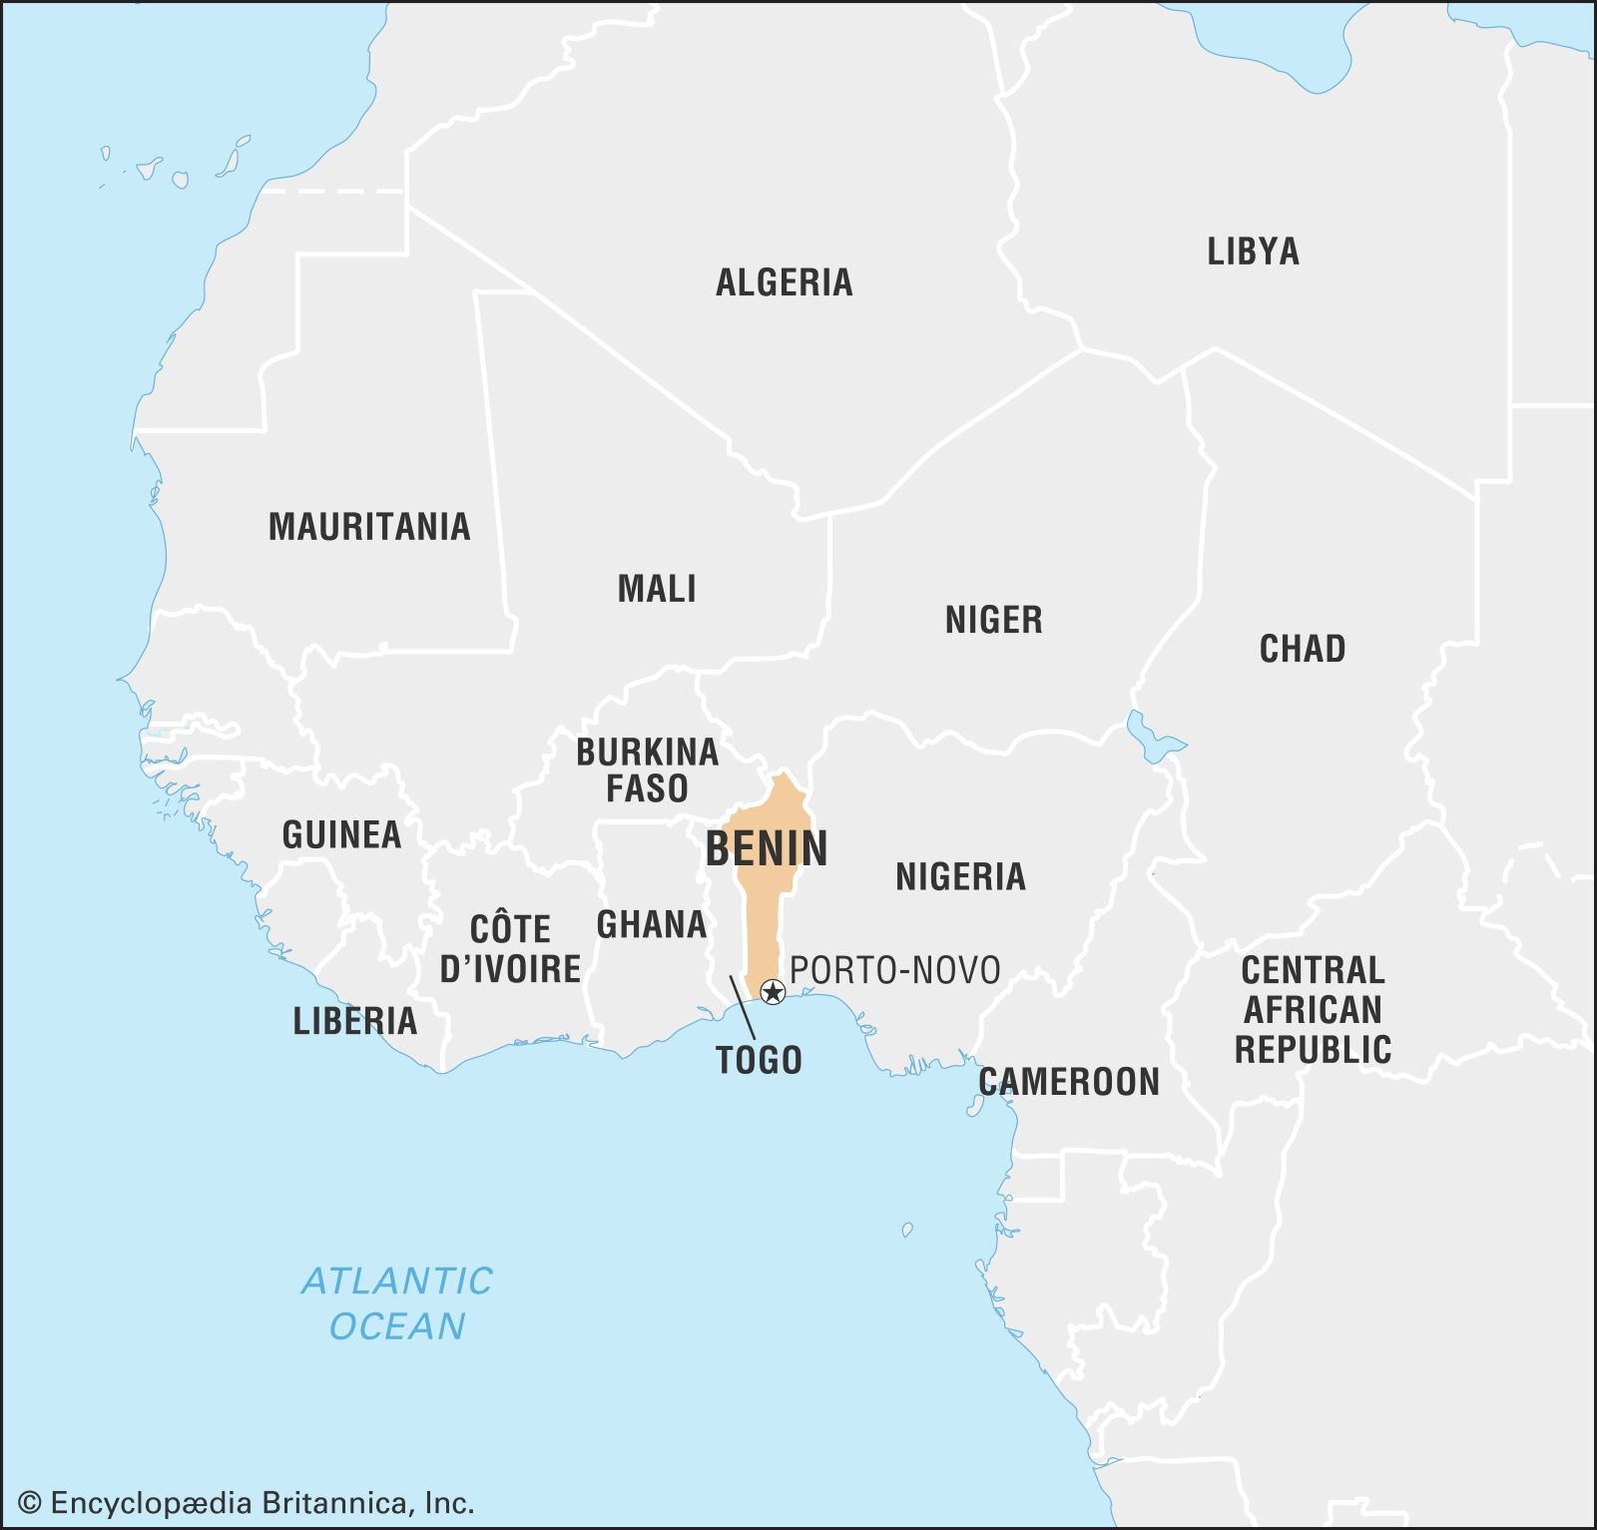
Objectives
Understand air quality trends in Benin and its cities
Integrate different air quality measurement types
Produce visualizations, determine if trends significant
Find low-cost sensor deployment locations in Cotonou
Notes:
Objectives

Slide 3
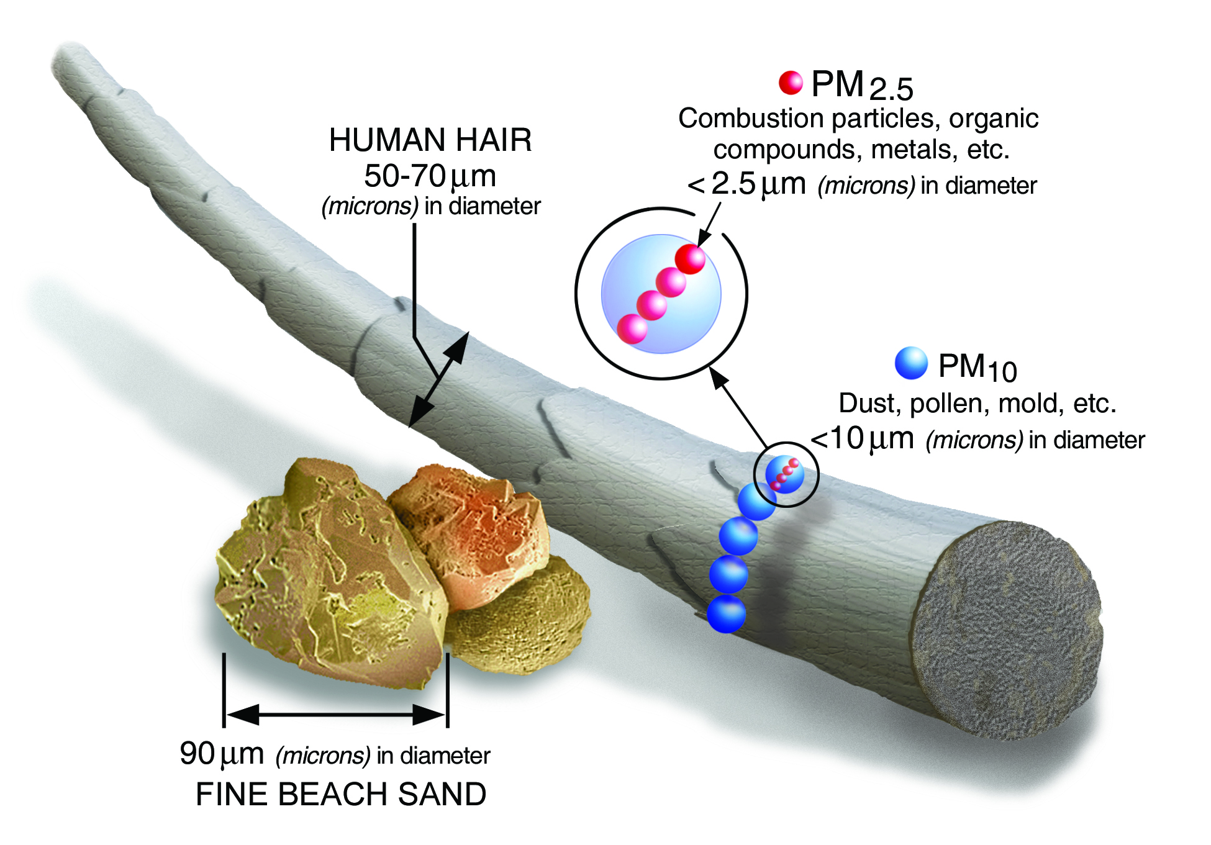
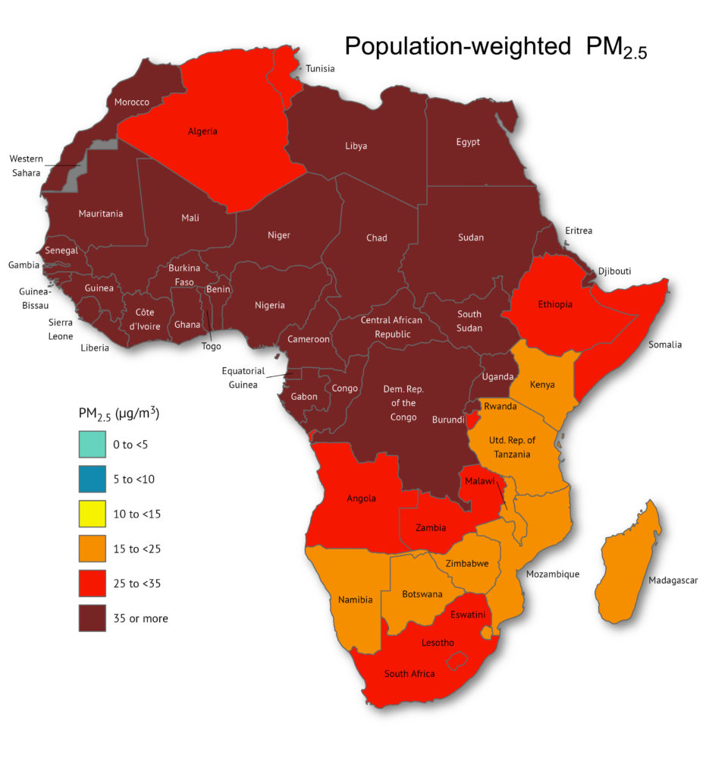
Background
PM2.5 = Particulate matter < 2.5 μm
Anthropomorphically or naturally created – varying causes and manifestations
Inhalable, likely to enter deep lungs, contributes to millions of deaths - bronchitis, asthma, COPD
Asia and Africa experience the highest attributable rates of death and have the lowest monitoring
Notes:
Background: Basics

Slide 4
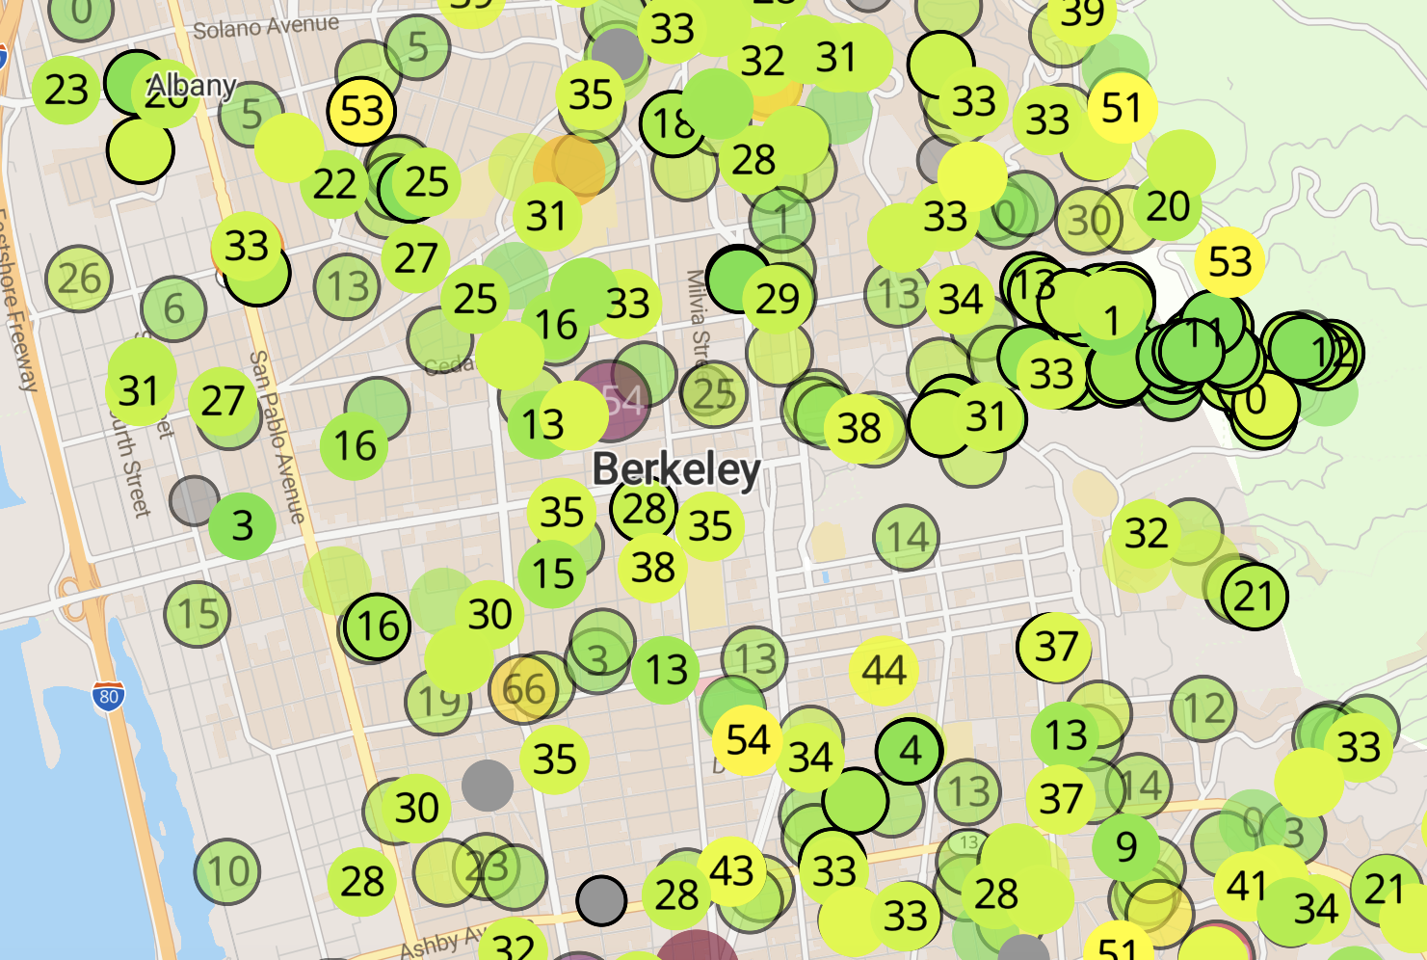
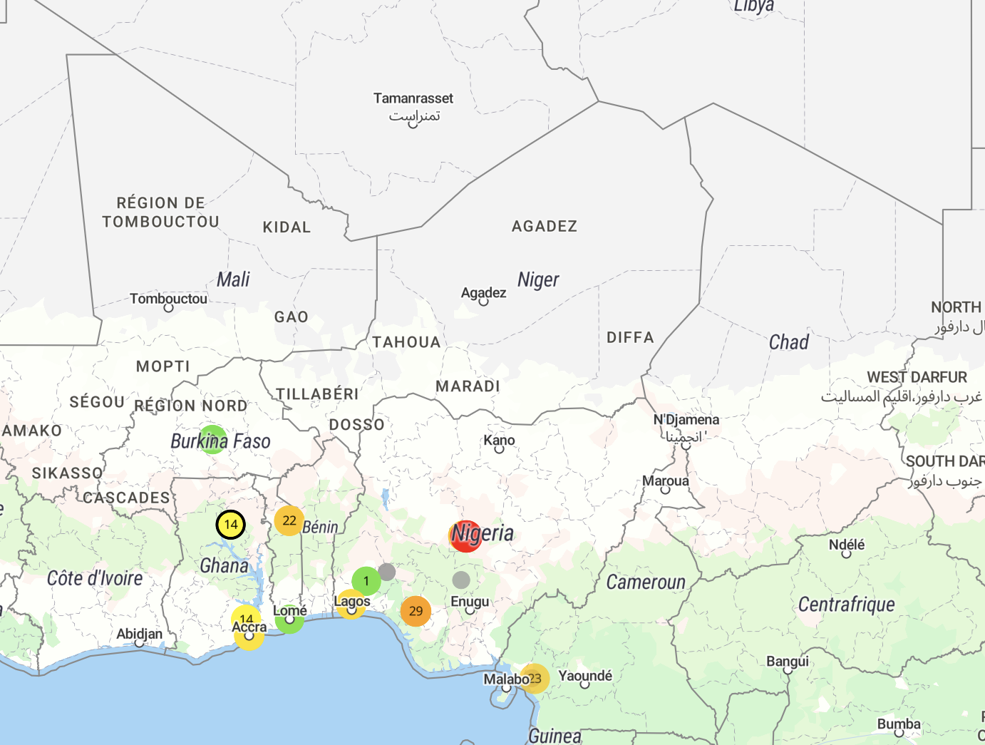
Notes:
Background: Disparity

Slide 5
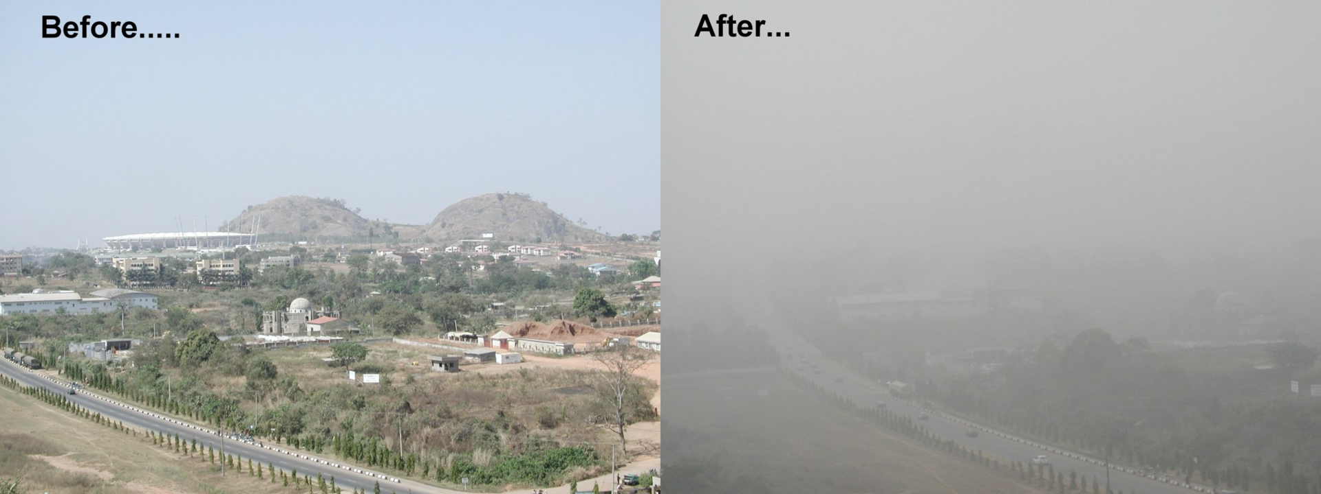
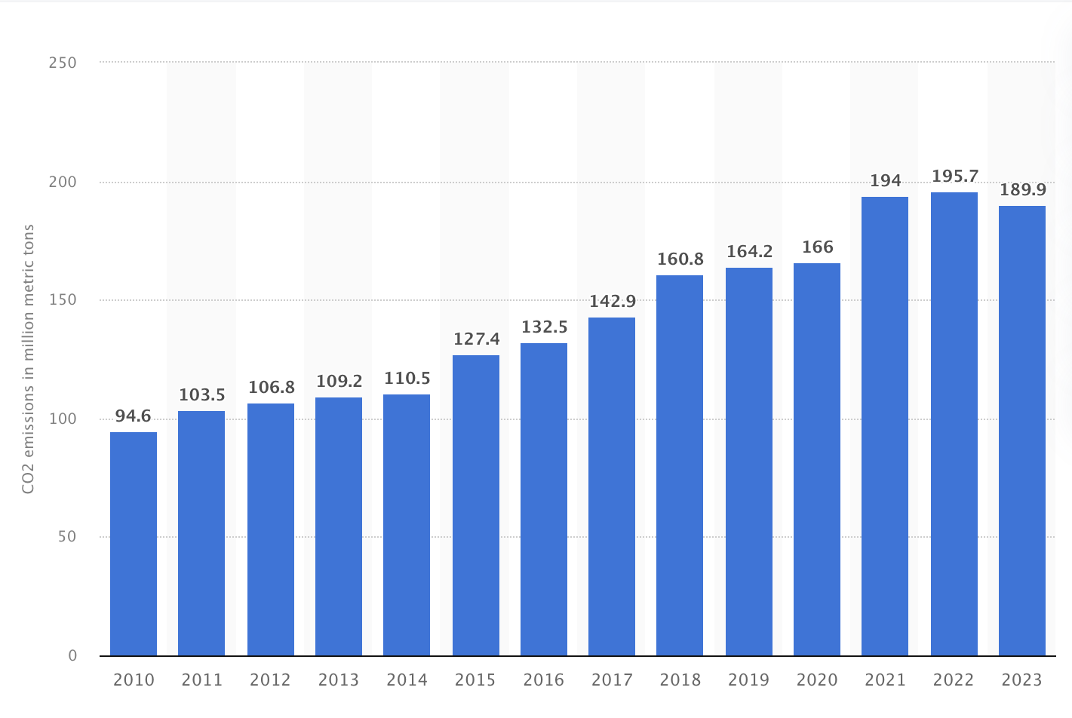
Background: Conditions in Benin
Seasonal weather changes from dust storm wind
Northeasterly wind blows dust from the Sahara, Nov-Mar - called the Harmattan
Rampant industrialization + urbanization in region
Increase in emissions in metropolitan areas, increase in CO2 and PM2.5
Notes:
Background: Unique Conditions in Benin

Slide 6
Hypothesis
Air quality in Benin will be highest during the Harmattan season due to trade winds and in the largest cities due to industrialization
On the ground Cotonou, Benin sensor data would provide more accurate data for the calibration function

Slide 7
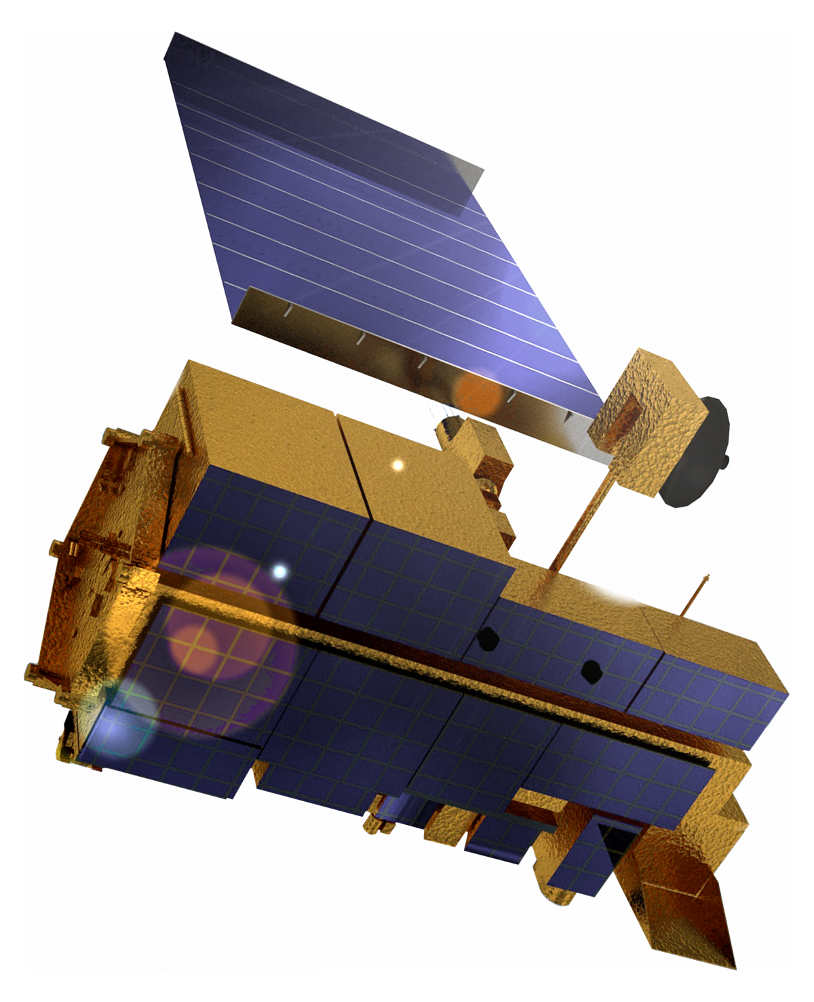
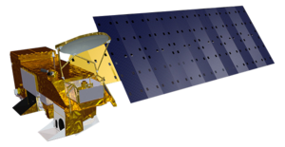
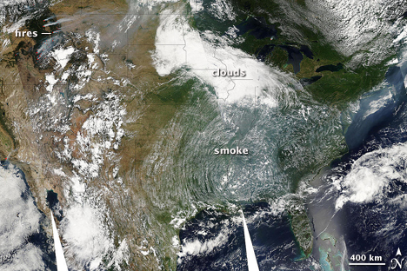
Satellite Data
NASA’s MODIS sampled at 1-KM resolution daily, entire earth
Air quality value is aerosol optical depth (AOD), dimensionless, light extinction
Higher when more aerosol, positively related to PM2.5 concentration
Need reference point and conversion function
Notes:
Data: Satellites

Slide 8
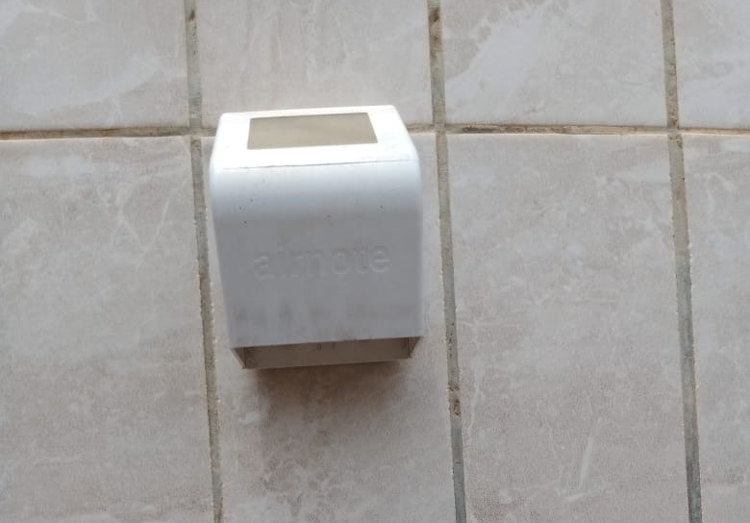
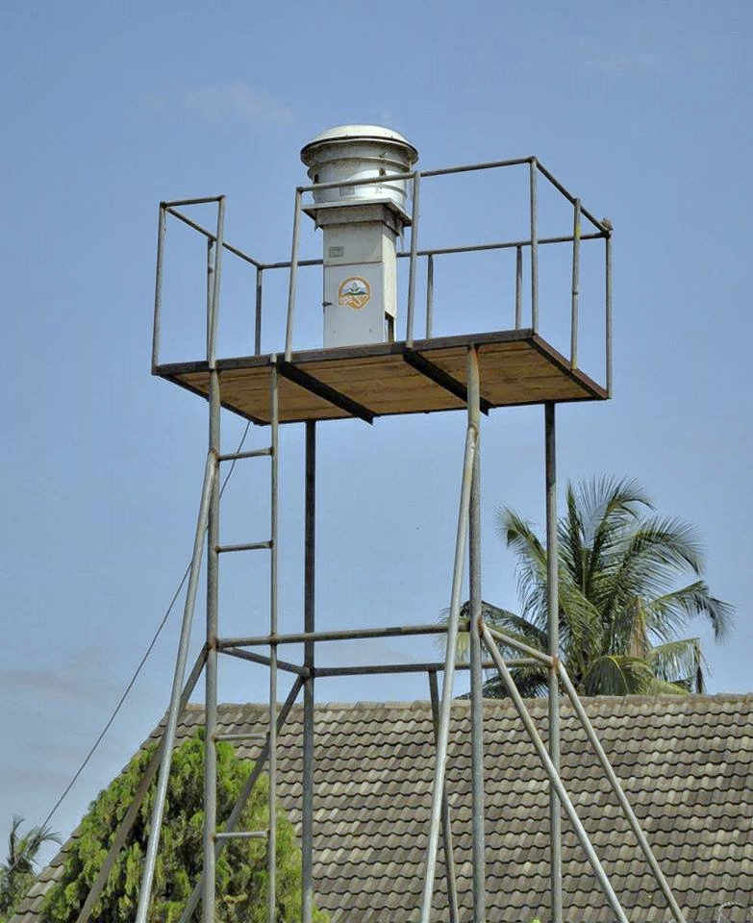
On-the-Ground Sensor Data
Two low-cost sensors on the ground in Cotonou, Benin: six months
One in a peri-urban area, one in a residential area
Managed by University of Abomey Calavi affiliates
Two high quality referential monitoring systems: complete
Lome, Togo
Accra, Ghana
Data for 2023, used this for conversion function
Notes:
Data: On-the Ground

Slide 9
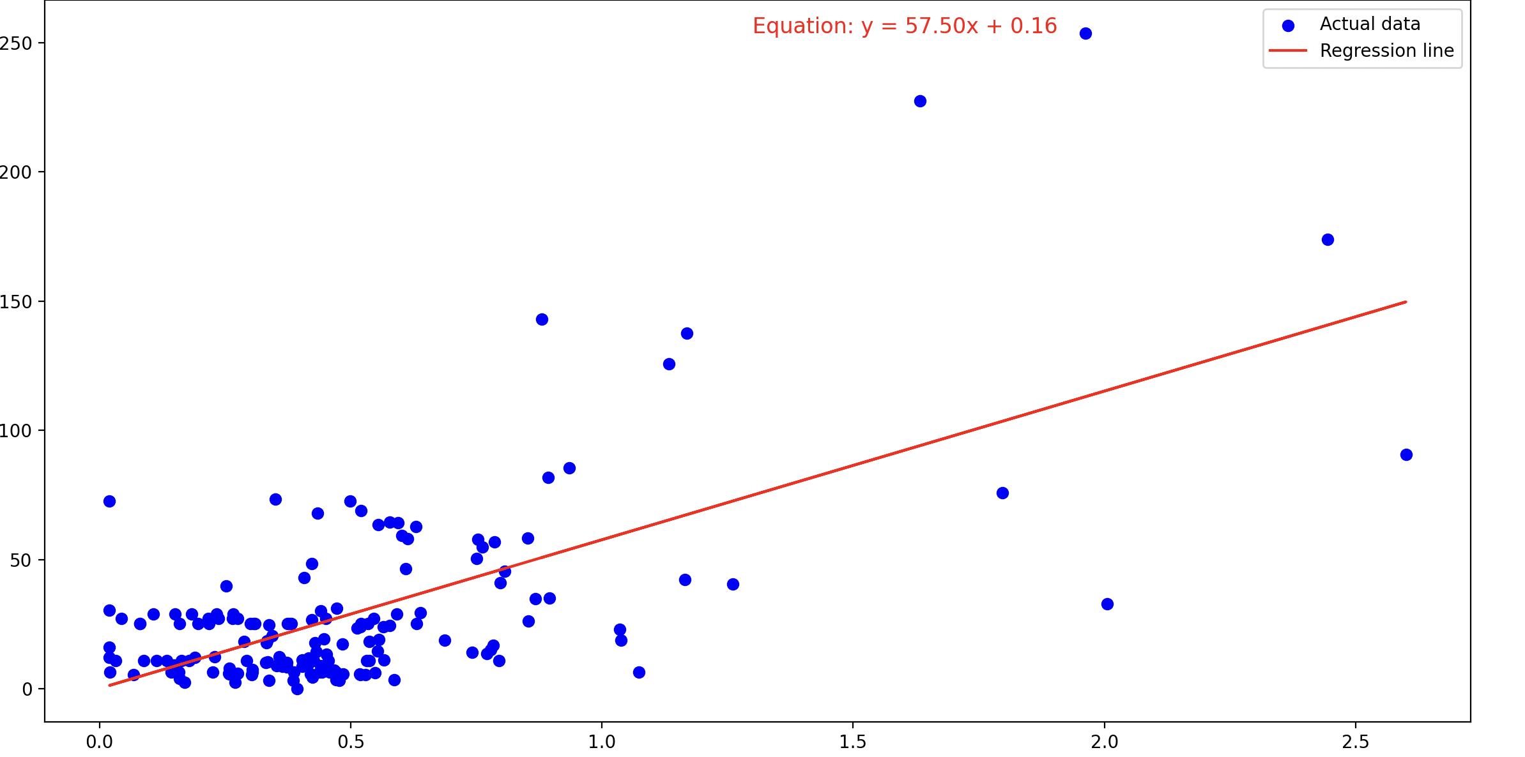
Methods: Function Generation
AOD averaged at all points, PM2.5 from sensor
Plotted daily AOD-PM2.5 pairs
Used Accra, Ghana data during 2023
Thus, Cotonou sensors were not used for the conversion function as incomplete
PM2.5 = 57.50*AOD + 0.16
Aerosol Optical Depth to PM2.5 Conversion
PM2.5 Concentration (micrograms/m^3)
Aerosol Optical Depth
Notes:
Methods: Using Accra daily on-the-ground sensor data and Benin daily AOD values to generate a conversion function.

Slide 10
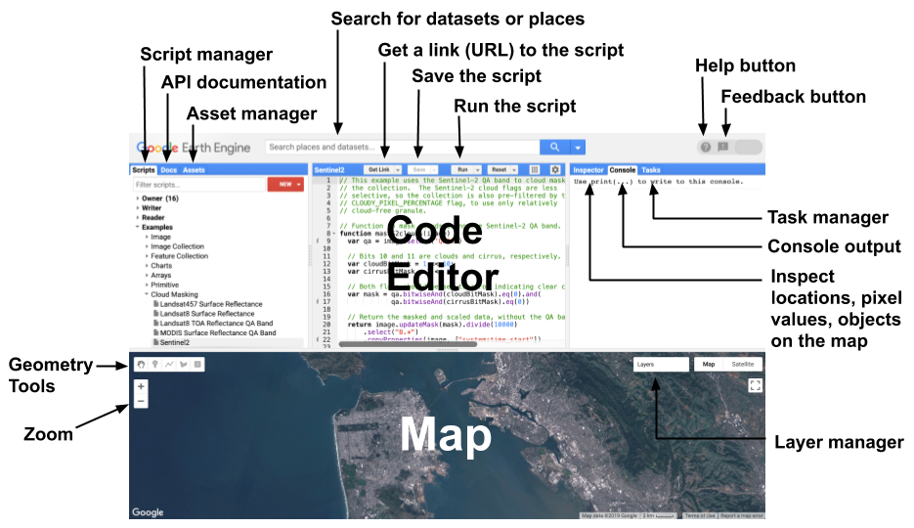
Methods: Data Processing
Benin + four cities were extracted 2019-2023, converted to PM2.5 through Google Earth Engine
Saved these as .csv files, loading everything through Python
‘pandas’, ‘seaborn’ packages for chart visualizations
‘scipy’ for statistical analysis
‘geopandas’ for maps
Notes:
Methods: Converted AOD values for Benin and four cities two PM2.5, different packages for analysis.

Slide 11
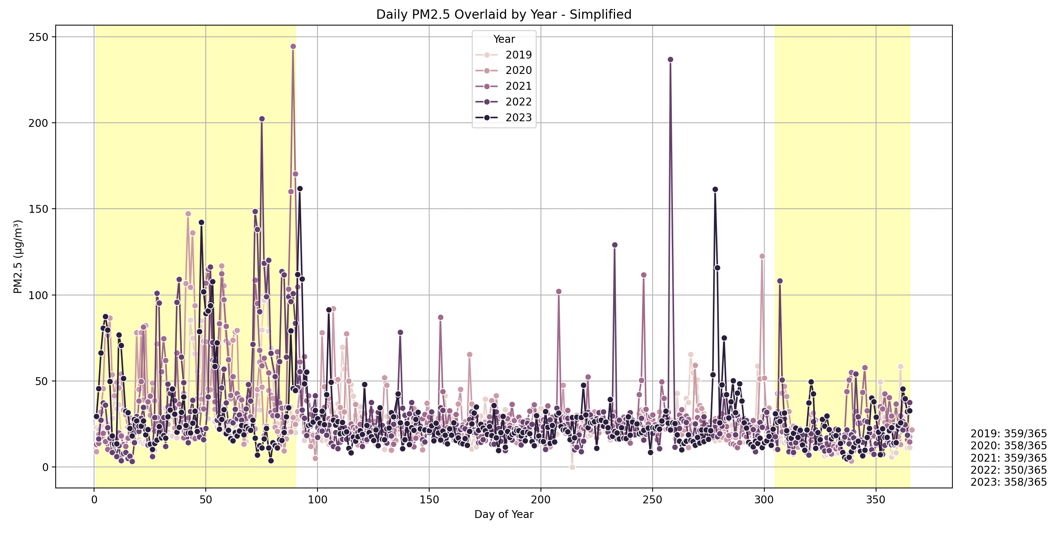
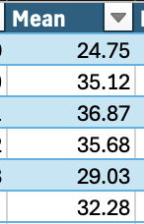
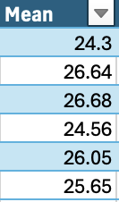
Benin Results
Harmattan
Non-Harmattan
Notes:
Results Benin Intertemporal: How are there differences in value over time?
(1) Mean and 90th percentile in Harmattan higher than non—Harmattan
(2) Unexpected, Harmattan lot lower in early Harmattan period than later Harmattan period
(3) Unexpected, residual after the Harmattan season

Slide 12
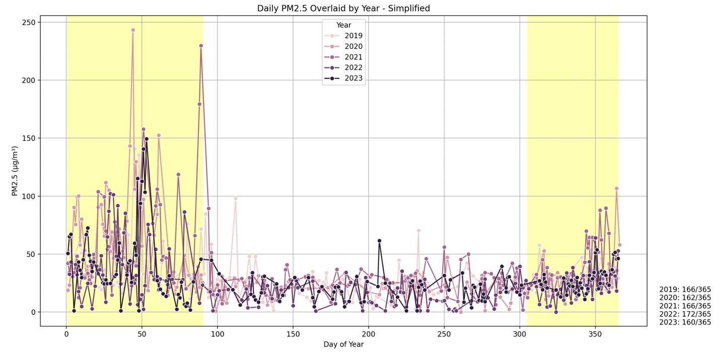
Cotonou Results
Harmattan
Non-Harmattan
Notes:
Results Cotonou Intertemporal: Showing same effect, some more missing data, however.

Slide 13
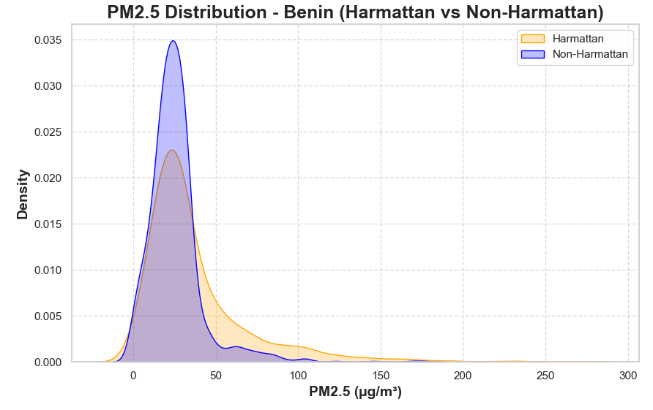
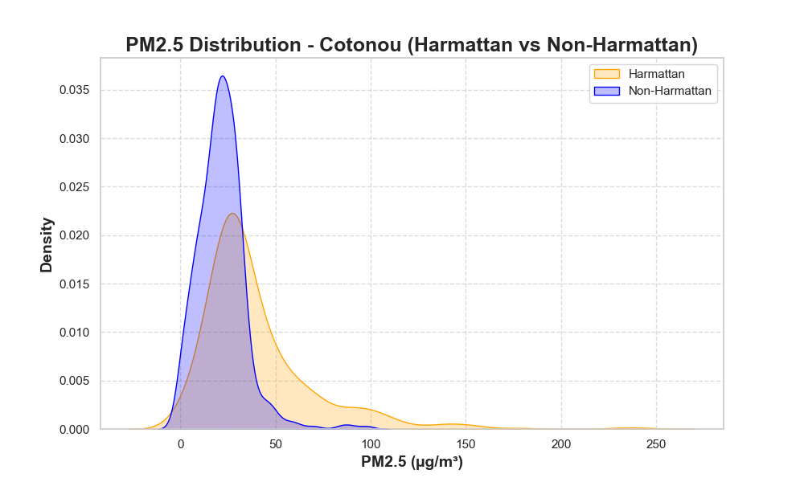
Intertemporal Effects: T-test
Location | T-statistic | P-value | Significant
Cotonou | 11.76 | 5.33E-29 | TRUE
Dassa-Zoume | 6.66 | 5.82E-11 | TRUE
Parakou | 2.22 | 0.027 | TRUE
Porto Novo | 6.73 | 4.04E-11 | TRUE
Benin | 13.25 | 5.45E-39 | TRUE
Mean | Median | Standard Deviation | Location (Harmattan)
40.18 | 31.39 | 30.60 | Cotonou
38.03 | 26.30 | 33.97 | Dassa-Zoume
36.53 | 26.45 | 32.71 | Parakou
34.64 | 25.47 | 33.16 | Porto Novo
37.38 | 27.75 | 32.67 | Benin
Notes:
Intertemporal Effect Significance: Is there significance in this intertemporal effect?
Ran a t-test. Yes, there is significance and we can reject the null hypothesis that there is no stat sig difference between seasons.
Show the distribution of PM2.5 on the left, how often it was a certain value. Higher and more distributed to the right during Harmattan.

Slide 14
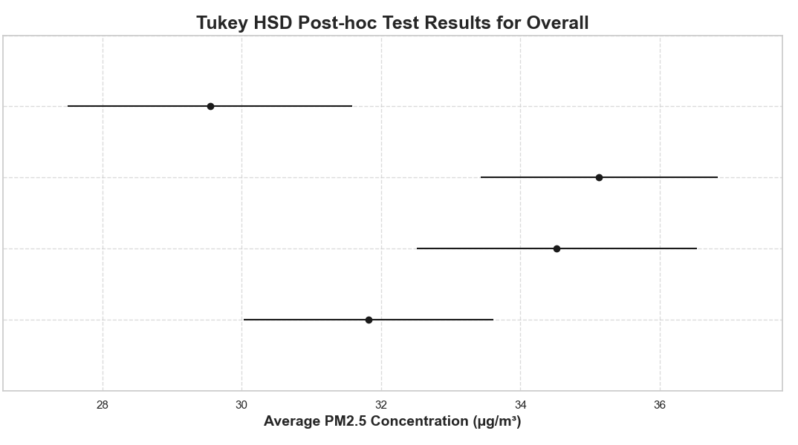
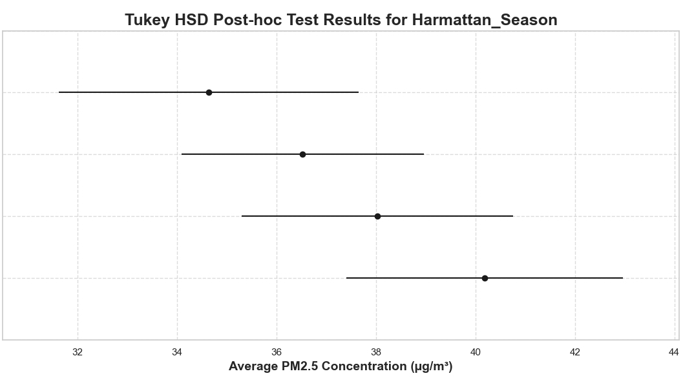
Interspatial Effects: ANOVA, Tukey HSD Tests
group1 | group2 | meandiff | p-adj | lower | upper | reject
Cotonou | Dassa-Zoume | 2.70 | 0.26 | -1.11 | 6.51 | FALSE
Cotonou | Parakou | 3.31 | 0.070 | -0.18 | 6.79 | FALSE
Cotonou | Porto Novo | -2.28 | 0.42 | -6.11 | 1.56 | FALSE
Dassa-Zoume | Parakou | 0.61 | 0.96 | -3.11 | 4.32 | FALSE
Dassa-Zoume | Porto Novo | -4.98 | 0.0085 | -9.02 | -0.93 | TRUE
Parakou | Porto Novo | -5.58 | 0.00070 | -9.33 | -1.84 | TRUE
Porto Novo
Parakou
Dassa
Cotonou
group1 | group2 | meandiff | p-adj | lower | upper | reject
Cotonou | Dassa-Zoume | -2.15 | 0.75 | -7.67 | 3.36 | FALSE
Cotonou | Parakou | -3.66 | 0.27 | -8.88 | 1.57 | FALSE
Cotonou | Porto Novo | -5.56 | 0.066 | -11.34 | 0.24 | FALSE
Dassa-Zoume | Parakou | -1.50 | 0.88 | -6.67 | 3.66 | FALSE
Dassa-Zoume | Porto Novo | -3.39 | 0.43 | -9.13 | 2.35 | FALSE
Parakou | Porto Novo | -1.89 | 0.81 | -7.35 | 3.57 | FALSE
Porto Novo
Parakou
Dassa
Cotonou
Notes:
Interspatial Effect Significance: Is there interspatial differences?
Despite seeing some statistical significance, there was a lot of missing interspatial data, so we are not sure we can conclude anything. We saw Dassa-Zoume and Parakou have higher average PM2.5 concentration values, however we are not sure why.
During the Harmattan, we saw that Cotonou did have the highest value for PM2.5so there may be a synergistic effect.
However, this is not statistically significant.

Slide 15
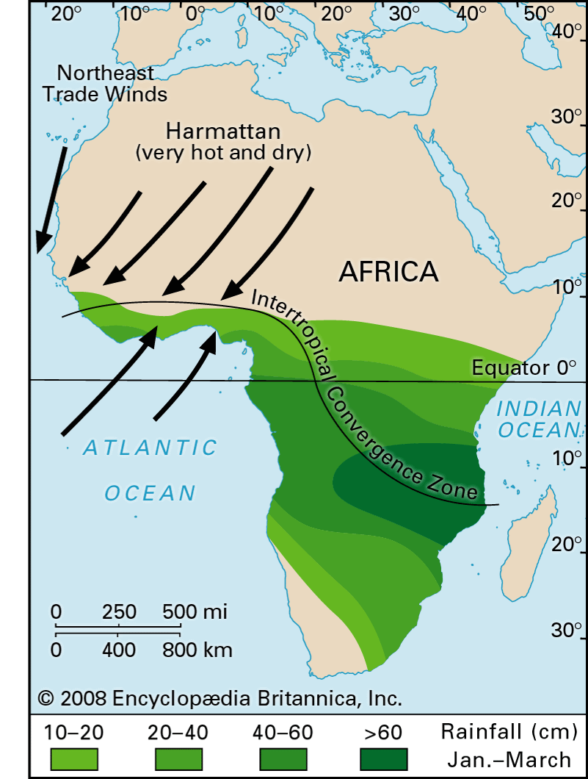
Harmattan Guide
Notes:
Since we did not find anything interspatially significant that was simpler to analyze (most of it would require advanced regression), we sought to ask the question: how does the Harmattan move through Benin, where does it effect, etc.? This is important because of policy implementations during the season.

Slide 16
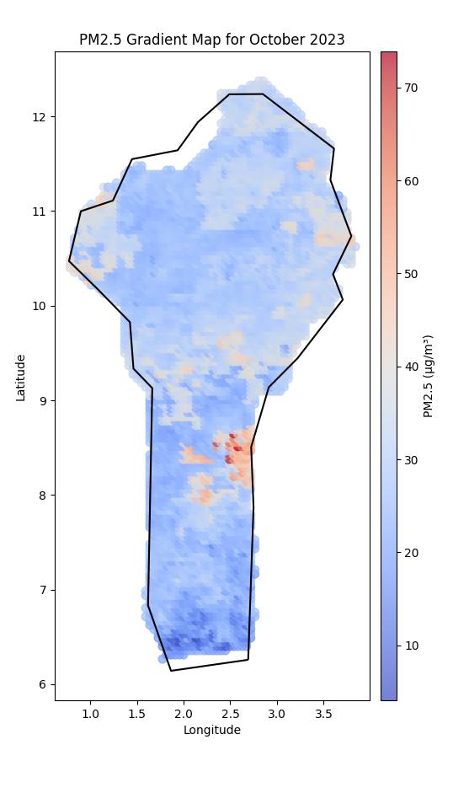
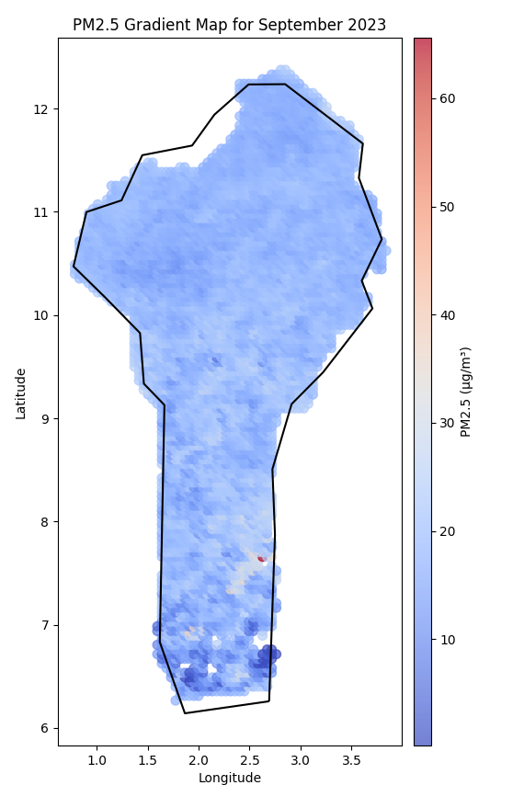
September-December: Harmattan Starts
September
October
November
December
Notes:
For all these maps, we took the coordinate PM2.5 from the month converted from AOD and plotted its average. Mention the Harmattan sweeping in, mention cities at bottom getting lots of concentration.

Slide 17
January-April: Second Wind from Above
January
February
March
April
Notes:
Now mention the break in February. Discrete Harmattan season rather than continuous. Then, this starts up again and we do not see as deep of a concentration in the southern cities.

Slide 18
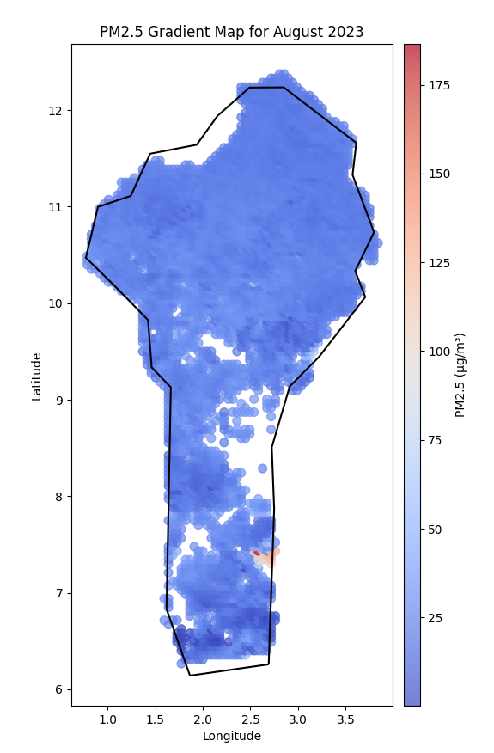
May-August: Harmattan Stops
May
June
July
August
Notes:
Here, we did not expect to see a residual effect, yet we did. Important to analyze how this wind happens so we can help Benin’s government intervene to put quotas on emissions or give people time off work hours. Also, this is the what we saw was statistically significant so we wanted to look more into it.

Slide 19
Cotonou Sensor Deployment
Dantokpa Market
Used map for August 2023, based off WHO PM2.5 guidelines
Three locations mentioned in Cotonou from affiliates were
Etoile Rouge monument
Dantokpa Market
Port of Cotonou
Two of these were in unhealthy PM2.5 ranges
Etoile Rouge
Port of Cotonou

Slide 20
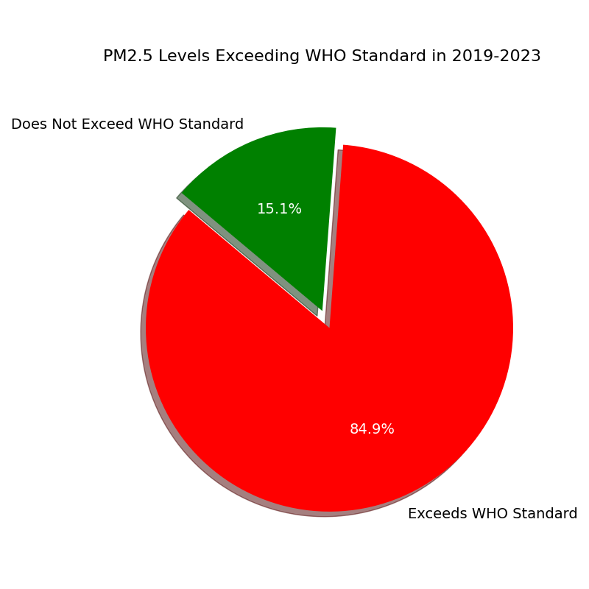
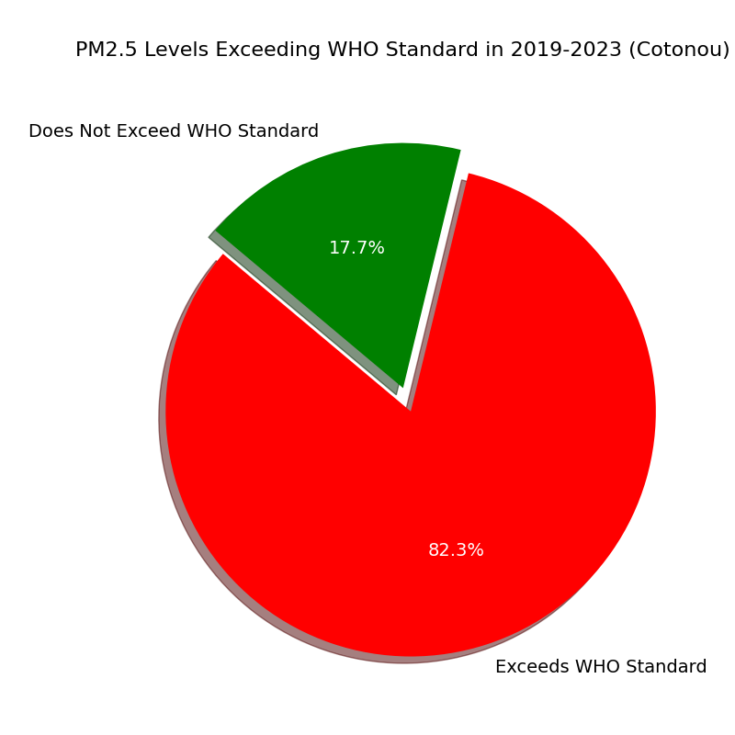
Comparison to World Health Organization Benchmarks
Benin
Cotonou
Notes:
How often to levels exceed the PM2.5 standard?

Slide 21
Discussion
Lots of missing MODIS data, improve QA and data imputation through ML
Improve interspatial analysis
Improve calibration models and conversion function
Inherent error in model, only used 2023
Determine how anthropomorphic PM2.5 contributes, advanced regression
Notes:
Mention missing data and interspatial analysus

Slide 22
Conclusion
Statistically significant PM2.5 concentrations intertemporally
Two discrete winds during Harmattan, near water and south winds mitigating
Despite protection, high early concentrations make Cotonou most affected during Harmattan
Difficult to conclude interspatial
In all areas, cities, and seasons, PM2.5 exceeds the WHO standard >70% of the time
Notes:
While it seems, Cotonou does seem protected and the PM2.5 does not linger, it has more days where it is highly concentration and there may be a synergistic effect – however, this does not happen during the non-Harmattan season
When its high during the first wind, its very high.

Slide 23
Acknowledgements
Mentor:
Professor Misbath Daouda
STEER Professors and Staff:
Professor Carisa Harris,
Jesús Alfaro
Maryanne Arceo
Gina Grayson

Slide 24
References
[1] Holloway, Tracey; Miller, Daegan; Anenberg, Susan; Diao, Minghui; Duncan, Bryan; Fiore, Arlene M.; Henze, Daven K.; Hess, Jeremy; Kinney, Patrick L.; Liu, Yang; Neu, Jessica L.; O’Neill, Susan M.; Odman, M. Talat; Pierce, R. Bradley; Russell, Armistead G.; Tong, Daniel; West, J. Jason; Zondlo, Mark A. (2021). Satellite Monitoring for Air Quality and Health. Annual Review of Biomedical Data Science, Vol. 4, 417-439. doi:10.1146/annurev-biodatasci-032521-100849.
[2] Chen, Wenqian; Ran, Haofan; Cao, Xiaoyi; Wang, Jingzhe; Teng, Dexiong; Chen, Jing; Zheng, Xuan (2020). Estimating PM2.5 with High-Resolution 1-km AOD Data and an Improved Machine Learning Model Over Shenzhen, China. Science of The Total Environment, Vol. 741, 141093. doi:10.1016/j.scitotenv.2020.141093.
[3] Apte, Joshua S.; Brauer, Michael; Cohen, Aaron J.; Ezzati, Majid; Pope, C. Arden, III (2018). Ambient PM2.5 Reduces Global and Regional Life Expectancy. Environmental Science & Technology Letters, Vol. 5, 546-551. doi:10.1021/acs.estlett.8b00360.
[4] Anderson, Jonathan O.; Thundiyil, Josef G.; Stolbach, Andrew (2012). Clearing the Air: A Review of the Effects of Particulate Matter Air Pollution on Human Health. Journal of Medical Toxicology, 8, 166–175. doi:10.1007/s13181-011-0203-1.
[5] deSouza, Priyanka; Kahn, Ralph A.; Limbacher, James A.; Marais, Eloise A.; Duarte, Fábio; Ratti, Carlo (2020). Combining Low-Cost, Surface-Based Aerosol Monitors with Size-Resolved Satellite Data for Air Quality Applications. Atmospheric Chemistry and Physics, 20, 5320-5337. doi:10.5194/acp-20-5320-2020.
[6] Lee, H. J.; Liu, Y.; Coull, B. A.; Schwartz, J.; Koutrakis, P. (2011). A Novel Calibration Approach of MODIS AOD Data to Predict PM2.5 Concentrations. Atmospheric Chemistry and Physics, 11, 7991-8002. doi:10.5194/acp-11-7991-2011.
[7] Kim, Ki-Hyun; Kabir, Ehsanul; Kabir, Shamin (2015). A Review on the Human Health Impact of Airborne Particulate Matter. Environment International, 74, 136-143. doi:10.1016/j.envint.2014.10.001.

Slide 25
References
[8] Fanou, Lucie A.; Mobio, Théophile A.; Creppy, Edmond E.; Fayomi, Benjamin; Fustoni, Silvia; Møller, Peter; Kyrtopoulos, Soterios; Georgiades, Panos; Loft, Steffen; Øvrebø, Steinar; Autrup, Herman (2006). Survey of Air Pollution in Cotonou, Benin—Air Monitoring and Biomarkers. Science of the Total Environment, 358, 85-96. doi:10.1016/j.scitotenv.2005.03.032.
[9] Dossou-Gbete, Sèdami Codjo Joël; Kpadonou, Dominique; Gbaguidi, An Magloire; Elegbede, Vitalique; Saizonou, Kpèssou Virtus Mickael; Youssao, Abdou Karim Alassane; Dovonon, Firmin Léonce; Vodounnon, Armand (2024). Distribution of Atmospheric Pollution in Southern Benin. Open Journal of Air Pollution, 13, 23-55. doi:10.4236/ojap.2024.131003.
[10] Lala, M.A.; Onwunzo, C.S.; Adesina, O.A.; Sonibare, J.A. (2023). Particulate Matters Pollution in Selected Areas of Nigeria: Spatial Analysis and Risk Assessment. Case Studies in Chemical and Environmental Engineering, 7, 100288. doi:10.1016/j.cscee.2022.100288.
[11] Daramola, Samson Gbenga; Makinde, Esther O. (2024). Modeling Air Pollution Around Major Dumpsites in Lagos State Using Geospatial Methods with Solutions. Environmental Challenges, doi:10.1016/j.envc.2024.100969.
[12] Léon, Jean-François; Akpo, Aristide Barthélémy; Bedou, Mouhamadou; Djossou, Julien; Bodjrenou, Marleine; Yoboué, Véronique; Liousse, Cathy (2021). PM2.5 Surface Concentrations in Southern West African Urban Areas Based on Sun Photometer and Satellite Observations. Atmospheric Chemistry and Physics, 21, 2801-2819. doi:10.5194/acp-21-2801-2021.
[13] Mahmud, Khaled; Mitra, Bijoy; Uddin, Mohammed Sakib; Hridoy, Al-Ekram Elahee; Aina, Yusuf A.; Abubakar, Ismaila Rimi; Rahman, Syed Masiur; Tan, Mou Leong; Rahman, Muhammad Muhitur (2023). Temporal Assessment of Air Quality in Major Cities in Nigeria Using Satellite Data. Atmospheric Environment: X, 20, 100227. doi:10.1016/j.aeix.2023.100227.
[14] McElroy, Sara; Dimitrova, Anna; Evan, Amato; Benmarhnia, Tarik (2022). Saharan Dust and Childhood Respiratory Symptoms in Benin. International Journal of Environmental Research and Public Health, 19(8), 4743. doi:10.3390/ijerph19084743.

